Slide 1
Welcome!
Community of Practice (CoP)
Focused on Equitable Placement and Completion
Information Session
May 8, 2024
Notes:
Denise
Welcome!
Thank you for joining us for our webinar announcing
One of EdTrust—West's Technical Assistance
For California's community colleges
Focused on equitable placement and completion
Before we begin, I will like to share a few announcements
Today's webinar will be recorded and saved on our website: Request for Applications: Community of Practice Focused on Equitable Course Placement and Completion - The Education Trust - West (edtrust.org)
Throughout the webinar, we encourage you to type questions in the Q/A
And we will answer your question
At the end of the presentation

Slide 2
Introduce the equitable placement and completion Community of Practice (CoP) model and opportunity
Explain the different phases of the work, including timeline and commitment expectations
Discuss the application process
Hear from interested colleges (questions/comments)
Goals of this Information Session
Notes:
Denise
The goal of today's informational session
Is to introduce
The equitable placement and completion
Community of Practice (CoP) model
And share about
This FREE opportunity for CA community colleges
We will explain the different phases of the work
Discuss the timeline, and
Commitment expectations.
We will discuss the application process/how to apply
And will have time at the end
To hear from interested colleges
And answer their questions

Slide 3
Presenters
Camille Medrano, Senior Educator Engagement Associate, EdTrust-West
Denise Luna, Director of Higher Education Policy, EdTrust-West
Megan Kane, External Relations Associate, EdTrust-West
Notes:
Denise
During today's presentations,
You will hear from my wonderful colleagues
At EdTrust—West including:
Camille Medrano, Senior Educator Engagement Associate
Megan Kane, External Relations Associate
My name is Denise Luna, Director of Higher Education Policy

Slide 4
Our Mission
The Education Trust–West is a nonprofit educational equity organization committed to dismantling the racial and economic barriers embedded in the California education system. Through our research and advocacy, EdTrust-West engages diverse communities dedicated to education equity and justice and increases political and public will to build an education system where students of color and multilingual learners, especially those experiencing poverty, will thrive
Notes:
Denise
EdTrust—West's mission is:
Committed to advancing policies and practices that dismantle the racial and economic barriers embedded in CA educational system.
Advocate for policy change
We develop research
And center practice changes at state & local levels
To build an educational system where students of color and multilingual learners, especially those experiencing poverty, will thrive

Slide 5
Why developmental education reform?
• Prior to AB 705 (2017), the vast majority of CCC students started in remedial courses
• Attrition was high, particularly for African American and Latinx students
• Few successfully transitioned to transfer-level English and math courses
• These practices and outcomes halted students’ academic progress
Citation: California Community College Chancellor's Office
Notes:
Denise
EdTrust—West's community of practice
Will focus on equitable placement and completion
To support the great work
CA community college have already accomplished
To ground our conversation
Developmental education reform
Has positively transformed our California community colleges
Prior to AB 705 (2017), the vast majority of CCC students
Started in remedial courses also known as developmental education
Students placed into remedial courses
Were much less likely to reach their educational goals
Attrition was high
Particularly for Black and Latinx students
Only a few successfully
Transitioned to transfer-level English and math courses
And ultimately,
These practice and outcomes
Halted students’ academic progress
This is data
From California Community College Chancellor's Office

Slide 6
A wholistic, multi-year student success reform
Goal: Maximize student success
Policy Reforms
Equitable Placement and Completion:
AB 705, AB 1805, and AB 1705
Citation: California Community College Chancellor's Office​
Notes:
Denise
In 2017, California passed
A wholistic student success reform
Called AB 705
With the policy goal
Of maximizing student success
California has 3 key policy reform
Of equitable placement and completion
AB 705, AB 1805, AB 1705
All rooted in data/research
And in the fundamental belief
That all students
Are capable of success
When given the change
And support to be successful
In summary,
The key components
Of the policies includes
Access, Enrollment, and Performance
For Access:
Comprehensively informing students
And the policies set a research
Standard of proof
For any below-transfer-level placements
For Enrollment:
Ensuring students enroll in transfer-level English and math courses
That aligned with their educational goals.
For Performance:
Ensuring students are
Supported in transfer-level courses
Through concurrent support
And ensuring
Equity in classroom via curriculum and pedagogy
Now I will pass it over to my colleagues
Camille to share more about the Community of Practice opportunity

Slide 7
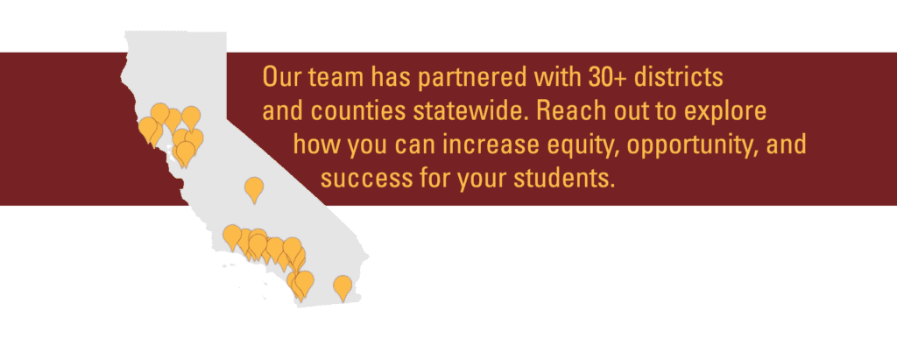
Educator Engagement Team
Notes:
Camille
An important part of ETW's theory of change is supporting policy implementation
ETW's educator engagement team works on the ground with schools, districts, and county offices of education
As one of the organizations first teams, we've built processes that have allowed us to support over 30 districts and counties – we're excited to extend this work to higher education
Our services ground in research and promising practices to support building equitable policies, practices, and systems
We collaborate with educators and administrators to conduct our Systemic Equity Review and Blueprint for Equity Action Plan
Partnership allows for district ownership in understanding data and creating a plan
We're excited to venture into this work with higher ed practitioners, using our proven processes and expertise

Slide 8
What is a Community of Practice?
A community of practice (CoP) is a group of people who share a common concern, a set of problems, or an interest in a topic and who come together to fulfill both individual and group goals.
Capture and share existing knowledge
Enable dialogue
Generate new knowledge
Stimulate learning
Notes:
Camille
Our team has engaged in facilitating communities of practice with TK-12 educators
We are excited about the possibilities for learning and engaging with higher ed practitioners in a community of practice model
A community of practice is usually a space build around a common issue, problems, or specific topic
Participants join the space to fulfill both individual goals and group goals
Folks may join from different institutions, locations, and contexts, but focus on addressing a common issue
CoP allows for cross-institutional dialogue from varying perspective
Enables participants and facilitators to share knowledge
Creates a space to stimulate learning from participants with varying perspectives
Generates new knowledge of approaching problem
This model suits the work of AB 1705 and efforts of practitioners across colleges
We intend to have two cohorts operating at the same time based on regional focus, one in the Los Angeles area and one focused in rural areas across the

Slide 9
Goals of the Community of Practice (CoP)
Build California community college teams' capacity
Engage California community college team stakeholders in conversations about educational equity and justice
Develop research-based action plans
Facilitate collaboration among college teams
Notes:
Camille
Build California community college teams' capacity to collect and analyze data, surface key findings, and identify root causes of inequities.
Engage California community college team stakeholders in conversations about educational equity and justice with the goal of forging a collective vision and commitment to action.
Develop research-based action plans (Blueprint for Equitable Implementation) to address systemic inequities in course placement and success in mathematics.
Facilitate collaboration among college teams to strategize about effective implementation of their action plans.

Slide 10
Overview of the CoP
Fall 2024
Three Virtual CoP Sessions
Blueprint for Equity Action Planning
October 2024 to December 2024 (Monthly)
Spring 2025
Implement Blueprint for Equity Action Plan
January to June 2025
Spring 2025
In-person Implementation Institutes
Share data, outcomes, and reflections on project reports and at two implementation institutes on March 12 and June 4, 2025
Fall 2024
One In-Person CoP Session
EdTrust—West Equity Forum on Mon, September 23, 2024, in Oakland, CA
Notes:
Camille
1 In-person CoP Session
September 23, 2024
Approx. 3 hours
Will include data coaching, analyzing college data, articulating a problem of practice, and understanding the self in relation to the problem.
3 Virtual CoP Sessions
Through October 2024 to December 2024
Approx. 2 hours, monthly sessions
Will include root cause analysis, developing a Blueprint for Equity Action Plan, analysis through an equity lens, and presentations of Plans.
Implementation Spring 2025
Consultation Office Hours
Data Collection and Analysis
Calibrating Action Plans

Slide 11
Benefits of Joining CoP
Free/no-cost to California Community Colleges
Travel reimbursement
In-kind technical assistance valued at $75,000 per team
Notes:
Camille
Thanks to generous support of Ascendium Education Group the community of practice technical assistance is
While no direct funding will be provided to colleges to participate, we

Slide 12
September 2024
1 in-person full-day CoP Session with college teams
January – March 2025
October – December 2024
Develop Blueprint for Equitable Implementation Plans
Quantitative and Qualitative Data Collection
CoP Feedback
March – June 2025
June 2025: Implementation Institute 2
3 virtual CoP Sessions with college teams
Share-out and Celebration
Quantitative and Qualitative Data Collection
March 2025: Implementation Institute 1
Approx. Every 4-5 weeks
Timeline of CoP 2024 - 2025
Participating college in the CoP will develop and implement Blueprint Plans with EdTrust-West
Notes:
Camille (hide 5/10)

Slide 13
Form and engage a team of 3-6 participants from your college
Attend each session as a team
Complete work in between sessions
Develop and implement a Blueprint for Equity (i.e., action plan) to implement equitable placement and completion policies
Share data, outcomes, and reflections in project reports and at two implementation institutes
Participating College Team Commitments
Notes:
Camille
Form and engage a team of 3-6 participants from your college.
Attend each session as a team, including the first in-person session in Oakland, CA on September 23, 2024.
Complete work in between sessions such as gathering data and/or meeting with key partners.
In consultation with colleagues and peers, develop and implement a Blueprint for Equity (i.e., action plan) to implement remediation reform effectively and equitably. Blueprint planning is a facilitated process to develop a detailed roadmap of what it will take to achieve the goal of an equitable course placement and success and completion.
Share data, outcomes, and reflections in project reports and at two implementation institutes in March and June of 2025.

Slide 14
Kick-off Session: Fall 2024
One In-Person CoP Session
EdTrust—West Equity Forum on Monday, September 23, 2024, in Oakland, CA
Notes:
Camille

Slide 15
Pre-Forum Institutes: September 23, 2024
Equity Forum: September 23-25, 2024
Marriott Oakland City Center
1001 Broadway, Oakland, CA 94607
Register: EdTrust -West Education Equity Forum 2024
Notes:
Camille

Slide 16
WHAT IS BLUEPRINT PLANNING?
A facilitated process to develop a detailed roadmap of what it will take to achieve the goal of an equitable course placement and success and completion.
College Teams
Works to create the Blueprint which includes actions and expenditures necessary to achieve goals.
Community of Practice
Other college teams will provide feedback to each other throughout the process.
Notes:
Camille
Throughout the CoP, we will support college teams in a process we've used in our previous K-12 district engagements
Using a blueprint planning model, teams will collect and analyze data, conduct root cause analysis, and identify actions tied to goals
Our team facilitates the process to support participants to develop a roadmap to achieve an established goal as specific to equitable course placement, success, and completion
College teams
Community of practice space

Slide 17
Blueprint for Equitable Implementation Planning (Blueprint) Fall 2024
The plan to address what will be done to increase equitable course placement and success.
3 Virtual CoP Sessions
Through October 2024 to December 2024
Approx. 2 hours, monthly sessions
Will include root cause analysis, developing a Blueprint for Equity Action Plan, analysis through an equity lens, and presentations of Plans.
1 In-person CoP Session
September 23, 2024
Approx. 3 hours
Will include data coaching, analyzing college data, articulating a problem of practice, and understanding the self in relation to the problem.
Notes:
Camille
Fall 2024, we will engagement in Blueprint Sessions
First session is in person at EER, as previously mentioned
The remaining 3 sessions will be virtual in October, November, and December

Slide 18
CoP Alignment to AB 705, AB 1705, &
Equitable Placement and Completion Grant
Problem of Practice Examples
How to develop corequisite support models?
How to align concurrent student support services?
How to create inclusive teaching practices, pedagogy, and classroom culture that supports all students?
What are promising practices when considering innovating course sequences?​
How to establish an innovative preparatory course for lowest STEM placement students?​
How have other colleges replaced stand-alone preparatory courses with support-enhanced STEM Calculus or linked corequisite support?
Notes:
Camille
The Blueprint action plan will be in alignment with AB 705, AB 1705 and Equitable Placement and Completion grant
Your college team will identify a problem of practice
A few examples can include:
How to develop corequisite support models? What are promising practices?
How to create inclusive teaching practices, pedagogy, and classroom culture that supports all students?
How to increase collaboration between faculty and Institutional Research and Planning Professionals (IRP) to evaluate the effectiveness and make improvements? How to create safe places for equity conversations and data analysis?
STEM problem of practice examples can include:
What are promising practices when considering innovating course sequences?
How to establish an innovative preparatory course for lowest STEM placement students?
How have other colleges replaced stand-alone preparatory courses with support-enhanced STEM Calculus or linked corequisite support?

Slide 19
[College Name] Blueprint for Equitable Placement Roadmap: Action Plan
Insert Logo
The set of actions highlighted on this map ensures accountability while leaving enough flexibility to pivot as the educational landscape changes. Each year of actions builds upon the prior to move toward ensuring every student has an equitable and humanizing educational experience that prepares them to thrive personally and academically. This roadmap summarizes important steps [District Name] will take over the next three years to catalyze improvements throughout the system. We owe our gratitude to the many voices who helped bring this roadmap to life.
1
Topic #1
2
Topic #2
3
Topic #3
4
Topic #4
5
Topic #5
Start
1
2
3
4
5
Action #1
Action #2
Action #3
Action #4
Action #5
Check-in
1
2
3
4
5
Action #1
Action #2
Action #3
Action #4
Action #5
Check-in
1
2
3
4
5
Action #1
Action #2
Action #3
Action #4
Action #5
Notes:
Camille

Slide 20
Implementation Spring 2025
Consultation Office Hours
Data Collection and Analysis
Calibrating Action Plans
EdTrust-West will continue to support colleges through implementation
Notes:
Camille
*This is the beginning of implementation*
Opportunity to troubleshoot in space with others
1st In-person Implementation Institute
March 12, 2025
Team will present progress made on implementing their plans, strategize with other participating teams, and refine their plans.
2nd In-person Implementation Institute
June 4, 2025
Team will present and share the impact of implementing their plan and EdTrust—West will celebrate participants' accomplishments and commitments

Slide 21
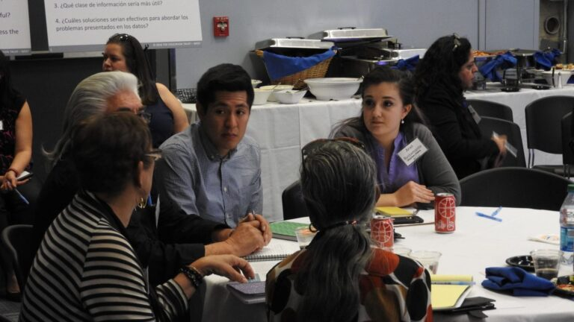
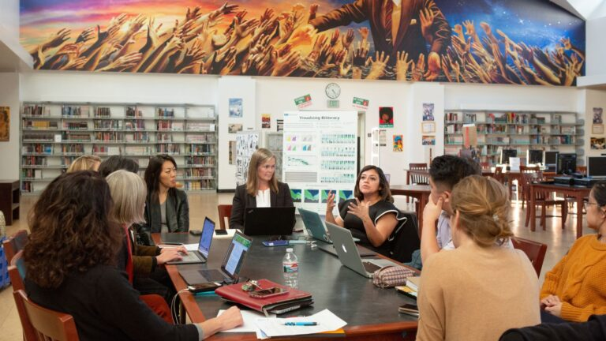
Implementation Institutes Spring 2025
1st In-person Implementation Institute
March 12, 2025
Team will present progress made on implementing their plans, strategize with other participating teams, and refine their plans.
2nd In-person Implementation Institute
June 4, 2025
Team will present and share the impact of implementing their plan and EdTrust—West will celebrate participants' accomplishments and commitments
Notes:
Camille

Slide 22
Applications are now open!
Priority Deadline: May 29, 2024
https://bit.ly/EP_RFA24
Notes:
Camille
Use the bitly link or linked application on our site to access the Google form to apply
One person should submit on behalf of the college team, and that person will serve as point of contact
Priority deadline is May 29th
Final deadline is June 28th

Slide 23
Important Documents
Request for Application FAQ Flyer
Notes:
Camille
Here are a couple documents for your reference that provide information about this opportunity
Could be useful to share with colleagues who may be part of your college team in this work
The first is the RFA Info Sheet that describes the opportunity, goals, and purpose
The second is a frequently asked questions doc that provides additional information about logistics and goals
The third is a one page flyer that succinctly shares the opportunity to participate

Slide 24
Application Preview
Complete 1 application per college team; identify a point person
Describe one or more equity challenge(s) you hope to address through your participation.
What are your goals for participating in the CoP?
Briefly describe to what extend your campus has fully implementation AB 705 and AB 1705.
Indicate college president support of participation in the CoP.
Notes:
Camille
Colleges only need to submit one application on behalf of their institution
One person should be identified as the point person
The application will ask you for some information about your institution's goals and progress

Slide 25
College Teams
Each college team should consist of 3-6 members. When building teams, consider including:
Administrator
Faculty
Institutional research and planning professional
AB 705 coordinator
Staff members working on equitable course placement and completion
Student leader
Notes:
Camille
Each college team will have 3-6 members comprised of various roles that relate to implementation of AB 705
You might consider including the following types of people or roles on your team:

Slide 26
Q&A
What can we clarify?
Notes:
Megan
https://west.edtrust.org/wp-content/uploads/2024/04/CoP-Equitable-Course-Placement-Completion-RFA-FAQs.docx

Slide 27
Contact Information
Denise Luna
dcastro@edtustwest.org
Camille Medrano
cmedrano@edtrustwest.org
Next Steps
Review the Request For Application (RFA)
Identify point person
Complete Application
Important Dates
Application Priority Deadline: May 29, 2024
Application Final Deadline: June 28, 2024
Will Send
Follow-up Email
Presentation Slides
Webinar Recording
Thank You!
Notes:
Denise
Thank you to everyone attending today's webinar, we hope the webinar was informative!
For next steps:
Please review the request for application (RFA) https://west.edtrust.org/wp-content/uploads/2024/04/ETW_2024_CoP-Equitable-Course-Placement-Completion_Application_Final.pdf
Identify point person who will complete the application
Submit your application by the priority deadline of May 29th or final deadline of June 28th
We will send
A follow-up email, presentation slides, and recording
They will also be available on our website Request for Applications: Community of Practice Focused on Equitable Course Placement and Completion - The Education Trust - West (edtrust.org)
We would also like
To thank the generous support of Ascendium Education Group!
With their support the community of practice technical assistance
Is at no-cost to California community colleges
Thank you again everyone for attending!
And if you have any questions please reach out to Denise or Camille.

